Slide 1
Programming Tutorial Course
michael.berks@manchester.ac.uk
Lesson 3: Data types and functions

Slide 2
Lesson overview
Forms of data
Types of data:
Numerical types, chars, strings, cells, structures
Ways of organising data
Arrays, cells, structures
Functions revisited
Optional input arguments
Multiple output arguments
Nested functions

Slide 3
Numerical data types
So far, the numbers we have used have been stored in memory as 'doubles'
These use 8 bytes of memory per array element
Represent very small, to very large numbers, to lots of decimal places
Sometimes we know data can only take certain values
E.g. The pixels in an 8-bit gray-scale (black and white) image can only have discrete integer values 0,1,…,255
We can store these as type uint8 – i.e. unsigned 8-bit integers
These only use 1 byte per array element
More efficient to store, process etc.
See also uint16, uint32, int8, single etc.
Images are often loaded by default into integer types

Slide 4
Numerical data types (cont.)
Different numerical data types can't be combined
i.e. can't add a 'double' to a 'uint8'
Some functions only work on certain data types
In general, it is safest to 'cast' data to a double before processing
If necessary can cast back to integer form when finished
Matlab
a = 2, b= uint8(2), c= int(2)
Type whos or use the function class(a)
Python
For any object type(a)
For np arrays, check the properties dtype and nbytes (e.g. a.dtype)
See datatype_example is this weeks shared material

Slide 5
Characters, Strings
Sometimes we want to store alphanumeric data, e.g.
Graph labels
Filenames
Header information associated with images etc.
A character array, or 'char' is a data type containing such data
Can create explicitly using ''
a = 'a';
A row vector of characters forms a string
abc = 'abcdefg';
Can index this like a numerical array, abc(5) – remember python indexing starts at 0
Matlab: can also create 2D arrays (or more), but we don't do this
Python: strings are represented by the str object, a very powerful class with lots of features
https://www.w3schools.com/python/python_strings.asp

Slide 6
Logical data
True or false?
Useful for choosing what actions to take
if x < 0; x = -x; end
We'll look more at if clauses later
Also can be used to index into arrays
X = rand(5, 3);
b = X < 0.5;
b is 5x3 array of logical values, 1 (true) where X is less than 0.5, 0 (false) otherwise
y = X(b);
Logical indexing, y is a column vector of all the values in X less than 0.5
Can be created directly using true and false
Like the functions ones, zeros
Use to 'mask' images

Slide 7
Organising data: cells
So far we've looked at arrays
Often it is useful to group data of different lengths together
Especially for strings, e.g. a list of names
Can't store as rows/columns of a 2D array (unless we use some NULL fill value)
Cell arrays allow us to overcome this problem
A cell array is like a normal array, except each element (or cell) can contain anything
See organising_data_example
Python: more choices, a list is probably easiest
https://www.w3schools.com/python/python_lists.asp

Slide 8
Organising data: structures
Another common requirement is to have a bunch of information repeated for lots of object
E.g. like a database, where each entry has multiple fields
For this we can use a structure array
Try file_list = dir();
Creates an nx1 structure array, with one element per file/folder in the current folder
Each element contains fields:
name, date, bytes, isdir, datenum
The elements can be indexed just like a normal array
The fields within each element are accessed using '.'
file_list(3).name returns the name field of the third element
More examples in the script
Python: again, more choice, but probably use a dictionary
https://www.w3schools.com/python/python_dictionaries.asp

Slide 9
Numerical types – the 'cargo'
Uint8 – integers up to 2⁸ fit into a small box
Uint16 – integers up to 2¹⁶ , need a bigger box
0
255
0
65535
1
1
What if we want to store any decimal number?
Double
box
-1.23456789
Easiest to work with doubles…
… can always store smaller cargo in bigger box, but not vice versa
3.1415926535897931

Slide 10
The containers – standard arrays
Array of uint8
Always need to be rectangular, and store the same cargo
2
8
9
1
9
0
4
0
5
3
7
1
Array of doubles
2.0
8.0
9.0
1.0
9.0
0.0
4.0
0.0
5.0
3.0
7.0
1.0
Array of char
'D'
'a'
'v'
'i'
'd'
'I'
'a'
'n'
'\0'
'\0'
'M'
'i'
'k'
'e'
'\0'

Slide 11
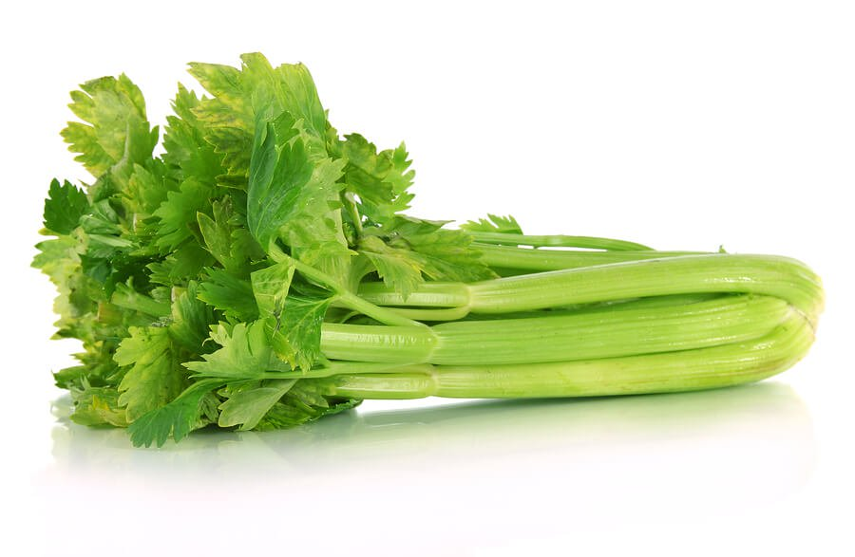
The containers – cell arrays
Can store different types and different sizes of cargo….
'D'
'a'
'v'
'i'
'd'
'I'
'a'
'n'
'M'
'i'
'k'
'e'
Note the outer containers, the pink cells, must be arranged in rectangular shape (in this case 3 x 1), as with standard arrays…
… but what's in the cell can be any data type, any size

Slide 12
Data Types Summary
Matlab and python have lots of numerical data types, as well as strings and logicals
In general, when working with numbers it is safest to use doubles
Cells and structures can be used to group data in situations where a regular array is unsuitable
This often makes life easier…
… however, understanding how regular arrays work is still the most useful skill in conquering Matlab!
More choice of different data structures, three in-built types you should get used to using are
List, dictionaries, tuples…
… but images will be numpy arrays

Slide 13
Now we return to looking a functions….

Slide 14
Functions: Optional inputs
Optional inputs are a very common feature of many existing functions
Try X = reshape(1:15, 5, 3);
X_bar1 = mean(X);
Takes mean of each column
X_bar1 is 1x3
X_bar2 = mean(X, 2);
Take's mean along 2nd dimension
X_bar2 is 5x1
mean(X) is equivalent to mean(X, 1)
The 2nd input is optional

Slide 15
Optional inputs
Useful when we want a function to behave in a particular way most of the time...
... but want the option of changing that behaviour in some circumstances
Mandatory inputs (if any) always appear first in the arguments list
If we give more inputs than are listed in a function, we generate an error
y = my_fun(2, 4, 8);

Slide 16
Optional arguments (cont)
Now try X = rand(1,3); X_bar = mean(X);
X_bar is 1x1, the mean of the vector X (and not the mean along each column)
mean(X) behaves differently, depending on whether X is a vector or a 2D array
Note mean(); produces an error – the first argument is not optional!
Try
X = rand(5,3);
X_asc = sort(X); X_des = sort(X, 'descend'); X_asc2 = sort(X,2);
Behaves differently, depending on arguments type
Matlab has no mechanism for type-checking arguments
If you use arguments of the wrong type, Matlab may crash
Try mean('fred');

Slide 17
Optional argument pairs - Matlab
Functions with lots of options, may use 'String/Value' pairs
plot(1:5, rand(1:5), 'r-x', 'LineWidth', 2.0, 'MarkerSize', 10);
String specifies the option name,
E.g. 'MarkerSize', 'Xlabel', 'Color'
Value is the argument itself
E.g. 12, 'Time (s)', [109 0 157]/256
String/value pairs can usually be given in any order
plot is a good example of a function that has
Optional arguments
Arguments of different type causing different effects
Lots of string/value pair options
We'll return to plot throughout the course, but for now try
plot(2:2:8); plot(2:2:8, 'r-x'); plot(2:2:8, [4 1 3 2]);
plot(1:5, rand(1:5), 'r-x', 'LineWidth', 2.0, 'MarkerSize', 10);

Slide 18
Optional argument pairs - python
Optional input arguments much easier to work with in python
plt.plot(x, y, 'go--', linewidth=2, markersize=12)
Named arguments:
After positional
In any order
Use = sign
No quotes
Positional arguments come first

Slide 19
Functions: Multiple outputs - Matlab
Last week we used the function min with 2 outputs
[min_val min_idx] = min(X);
min_val is the minimum of the vector X
min_idx is the index in X where the minimum is found
Both min_val = min(X); and min(X); are also valid
Functions can list any variables as outputs
When called we can assign any number of these
However, they will always be assigned in order listed
If we try and assign more outputs than are listed we get an error
What if X is a matrix?

Slide 20
Multiple outputs (cont) - Matlab
What if we just want min_idx?
Recent versions of Matlab (>2009) can use ~
[~, min_idx] = min(X);
Means the first argument won't be assigned
Pre-2009 you could use [d, min_idx] = min(idx); clear d;
Try X = rand(4, 5, 3);
S1 = size(X);
[S2_1, S2_2] = size(X);
[S3_1, S3_2, S3_3] = size(X);
The number of outputs assigned may change what the outputs mean

Slide 21
Multiple outputs (cont) - Matlab
What happens when we use a function in an expression?
Only the first output is returned
The function behaves as if 1 output is listed
Try
2*size(X)+1
dims = 2*size(X)+1;
[r c] = 2*size(X) + 1;

Slide 22
Multiple outputs (cont) - python
In python multiple outputs are
Returned as a tuple
A = np.zeros((2,3,4))
A_shape = A.shape
May be unpacked automatically
dim1,dim2,dim3 = A.shape
However must ask for correct number
dim1,dim2,dim3,dim4 = A.shape Error!
dim1,dim2 = A.shape Error!
Can use indexing to select specific outputs
dim1,dim2 = A.shape(inputs)[0:1]

Slide 23
A standard function template - Matlab
function [out1,out2,out3,...] = ... fun_name(in1,in2,...)
%Comments describing function
%Followed by lines of code that do
%stuff to compute out1, out2 etc.
out1 = in1^in2;
...
end %Is optional

Slide 24
A standard function template - python
def fun_name(in1,in2,..., named1=None, named2=[],…):
'''Comments describing function
Followed by lines of code that do
stuff to compute out1, out2 etc'''
out1 = in1**in2
...
return out1, out2,…
Must have :
Must have indent

Slide 25
Nested functions
Can also define one function inside another
Used to provide auxiliary (i.e. helper) functions to the main function
Only the main function is visible on the Matlab path (i.e. available for other functions/scripts to call)
The helper functions can only be used by the main function
Depending on where the helper function is placed in the main function changes how it shares memory with the main function
All about the keyword 'end'
See example functions in this week's shared materials

Slide 26
Functions revisited - summary
Function arguments may be optional
Some may be mandatory
These always appear first in the argument list
Arguments of different size, type etc may change the way the function works
Function outputs are always optional
Outputs are assigned in order listed
Assigning to a different number of outputs may change the way the function works
Functions can have nested 'helper' functions
Only visible to the main function
Can share the main function's memory or be separate

Slide 27
Matlab's help menu
Matlab has an extensive, (and very useful!) help menu
From the command window, for any function you can type 'help' followed by the function name. E.g.
help size
This provides a summary of the function in the command window
It will describe
The inputs the function takes
The outputs the function produces
How the behaviour of the function changes depending on the number/type of inputs and outputs specified
There will usually be links to other related functions ('See also:') – these are often very useful

Slide 28
Matlab's help menu
If you type: 'doc' followed by the function name, you get a description of the function in the main help menu (often with example images, plots etc)
doc colormap;
You can access the full help menu via the main toolbar: click “Help -> Documentation”
You can use this to search for functions
This is particularly useful for finding functions when you know what you want them to do (e.g. calculate standard deviation), but don't know (or can't remember!) what they are called

Slide 29
Task:
Split into groups
Matlab: use the help menu explore the functions from the slide assigned to your group
Python, just use google
After 15 minutes, describe to the rest of the class what the functions do. E.g…
What main inputs do they take?
What are the main outputs?
Using the “see also” links, find one other related function NOT listed on your slide and describe this too
Note: where functions have lots of different input/output options, only describe the first 2 or 3

Slide 30
Summary statistics
sum
mean
median
min
max
var
std

Slide 31
Data manipulation
sort
unique
sortrows
find
ismember
isin
nonzero

Slide 32
Sampling and creating data
ones
zeros
eye
rand
randn

Slide 33
Integer arithmetic
ceil
floor
round
mod
rem
remainder

Slide 34
Data information
size
length
numel
isempty
isnan

Slide 35
Mathematical + Logical operators
+, -, *, .*, /, ./, ^, .^, sqrt
>, <, &, |, ~, &&, ||
inf (and –inf)
nan

Slide 36
Summary
Matlab and python have thousands of useful functions for you to use
Luckily the help menu means you don't need to remember all of these!
However, being familiar with the most common functions will make solving common tasks a lot faster and easier*
Think of it like learning a foreign language:
Understanding how to use functions and connecting code together is like learning the grammar
Learning the names of common functions is knowing the most common nouns, verbs etc so you can just use these without looking them up all the time
For everything else, the help menu is your dictionary!
*That doesn't mean I expect you to memorise all the functions from this lesson! But you'll find you pick these up naturally

